Slide 1

B.Tech External Project Evaluation, VIIIth Sem
Project Title- Image processing using Deep Learning Techniques: Super Resolution
Presented by :
Ashima Jain, 2019003789
Arup Sarkar, 2019000503
Under the Supervision of:-
Mr. Shobhit Tyagi
Dr. Arun Prakash Agrawal
DEPARTMENT OF COMPUTER SCIENCE & ENGINEERING
SHARDA SCHOOL OF ENGINEERING AND TECHNOLOGY
May 2023
‹#›

Slide 2
PRESENTATION LAYOUT
Introduction
Motivation
Problem Statements
Objectives
Literature Survey
Workload distribution/ Team Work
Methodology
Model Architecture
Results
Conclusion and Future Scope
Outcome details
References
GitHub link

Slide 3
INTRODUCTION TO THE PROJECT
Image processing is the procedure of improving an image and extracting some useful information from it.
Deep learning is part of a subfield of machine learning methods based on artificial neural networks with representation learning.
The procedure of generating a high-resolution (HR) image from a low-resolution (LR) image is known as super-resolution (SR).

Slide 4
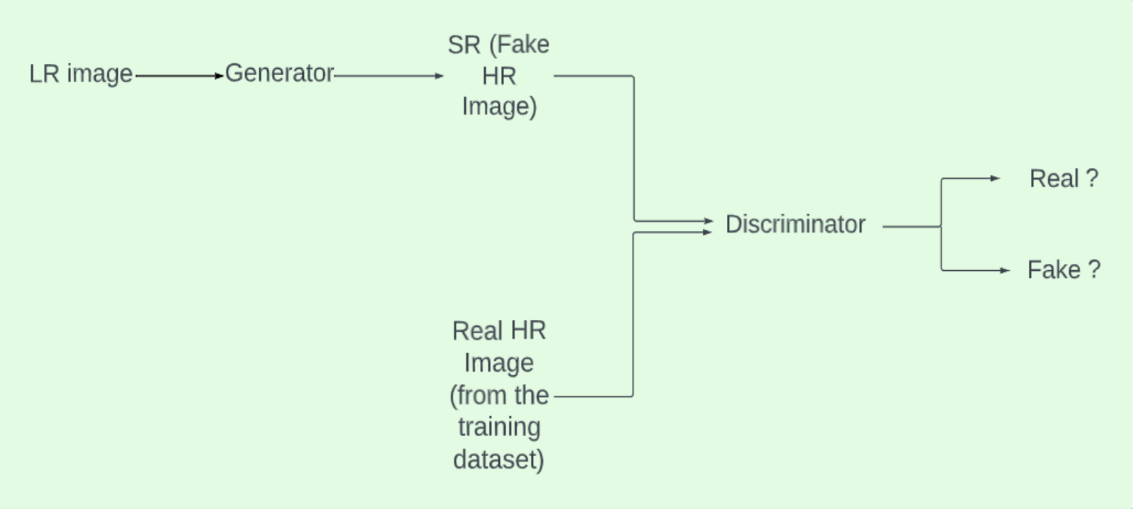
Fig. 1. Block Diagram of Super-Resolution using Generative Adversarial Network

Slide 5
MOTIVATION FOR THE PROJECT
Smaller size or degradation due to noise, camera de-focus, etc., might cause a picture to have a reduced resolution.
Medical imaging, forensic, surveillance, and satellite imaging all call for zooming in on a specific area of interest in the image, necessitating excellent quality.
Performing SR using a Generative Adversarial Network (GAN) can preserve the image's finer details and provide a sharper, improved HR image for large upscaling factors.

Slide 6
PROBLEM STATEMENTS
A high pixel density indicates that an image has a high resolution and is sharper and finer, and so contains more data and finer details about the original scene.
Due to the fact that high-quality photos carry more information than was genuinely present in LR photos, the topic has become a very well-known research area.
In spite of the use of faster, quicker and deeper CNNs for performing SR task, one major issue is still completely unresolved, i.e., how to retrieve the finer texture features when SR is performed at high upscaling factors.

Slide 7
OBJECTIVES
GANs are highly efficient for performing SR as they can preserve the finer details of the image and generate a sharper and enhanced HR image for high upscaling factors.
The proposed model is a generative adversarial network with inception modules and residual blocks in the generator and discriminator networks. It is an efficient and enhanced network for image super resolution.
We aim to perform 4 times (4×) upscaling.

Slide 8
LITERATURE SURVEY
Author(s) & Year | Citation | Proposed Model
Chao Dong, Chen Change Loy, Kaiming He & Xiaoou Tang (2014) | [1] | Super-Resolution Convolutional Neural Network (SRCNN) is the first super-resolution model to employ CNN. SRCNN has a straightforward architecture, with only three layers and no connecting or pooling layers. The network is made up of three components: non-linear relationship mapping, picture block extraction and representation, and HR image reconstruction. SRCNN has three convolution layers that implement the functions of the aforementioned three components.
Shi et al. (2016) | [2] | Efficient subpixel convolutional neural network (ESPCN) uses a subpixel convolutional layer at the completion to combine LR feature maps and execute a simultaneous estimation of HD space to recreate the HR image. It uses the original LR photos as network inputs without the need for any image preprocessing.
Chao Dong, Chen Change Loy & Xiaoou Tang (2016) | [3] | Fast SRCNN (FSRCNN) accelerates the SRCNN process and enhances the convolutional layer by bypassing bicubic interpolation and switching non-linear mapping for decreasing and expanding layers. A deconvolutional layer is added in FSRCNN towards the completion of the network to allow straight mapping from the LR picture to the HR image with no need of interpolation.

Slide 9
LITERATURE SURVEY CONT…
Ledig et al. (2017) | [4] | Super Resolution Generative Adversarial Network (SRGAN) consists of 2 networks, the generator and the discriminator.It can preserve the image's finer details and provide a sharper, improved HR image for large upscaling factors.
Namhyuk Ahn, Byungkon Kang, Kyung-Ah Sohn (2018) | [5] | Cascading residual network (CARN) uses Residual Neural Network (ResNet) Blocks to discover the connection among LR and HR input image and output image. The existence of global and local cascading modules distinguishes the two types. An 11 convolutional layer is formed by cascading and converging the features from in-between layers.
Wang et al. (2018) | [6] | By the removal of batch normalization (BN) and the addition of dense blocks, Enhanced Super-Resolution Generative Adversarial Networks (ESRGAN) [6] improvises on SRGAN. The output from every dense block is linked to the input of that particular block, creating a residual connection over each and every dense block. In order to impose residual learning, ESRGAN additionally contains a global residual connection.

Slide 10
LITERATURE SURVEY CONT…
Park et al. (2018) | [7] | SRFeat is another GAN based SR model that is based on feature discrimination. SRFeat focusses on generating high frequency structural characteristics instead of noisy artefacts from the input image utilising a supplementary discriminator that helps the generator do so. By separating the characteristics of generated and actual images, this requirement is met.
Wenlong Zhang, Yihao Liu1, Chao Dong, Yu Qiao (2019) | [8] | RankSRGAN employed a Ranker model in the SRGAN. The ranker is able to comprehend the perceptual metrics and is based on the Siamese architecture. They also introduced a new rank-content loss to enhance the perceptual quality of the images. The trained ranker is able to rank images as per their perceptual scores.
Nathanael Carraz Rakotonirina, Andry Rasoanaivo (2020) | [9] | ESRGAN+ presented a new basic block replacing the one used in ESRGAN. Noise inputs were also introduced to the generator network. An extra level of residual learning was added to the original residual-in-residual dense block presented in ESRGAN. A residual was also added after every 2 layers in each dense block.

Slide 11
WORKLOAD DISTRIBUTION/ TEAM WORK
Ashima Jain- Creation of the Deep Learning model, creation of functions for generator network, discriminator network, residual blocks, model training, deployment of trained model.
Arup Sarkar- Data collection, data pre-processing, Data visualization, model training and image plotting using Matplotlib.

Slide 12
METHODOLOGY USED
Inception Module
The inception module consists of 1×1 convolutional layers before the 3×3, 5×5 convolutional layers and after the 3×3 max-pooling layer.
The inception module helps to overcome the difficulty of deciding what filter size to use in the convolutional layers and when to add pooling layers.
The inception module uses different kernel sizes and concatenates the depth of all the outputs.

Slide 13
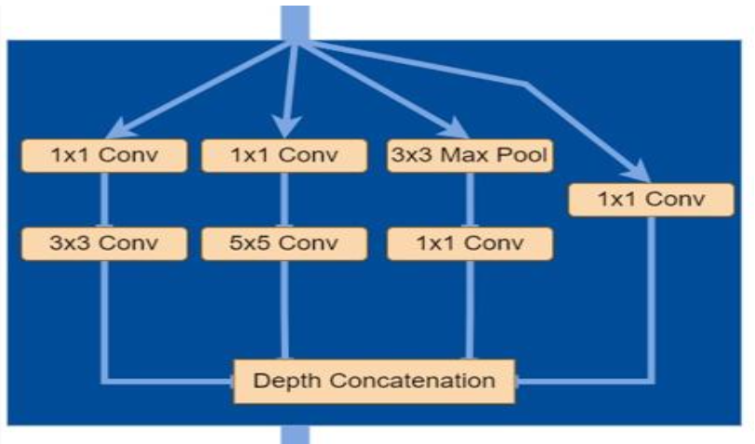
Inception Module

Slide 14
Residual Block
The residual block consists of a main path and a shortcut path.
The shortcut path is called the skip connection.
Skip connections are able to tackle the issue of vanishing or exploding gradient by bypassing a portion of the neural network's layers and sending the output of one layer as the input to later levels.
Skip connections also ensure feature reusability which is important for super resolution task.

Slide 15
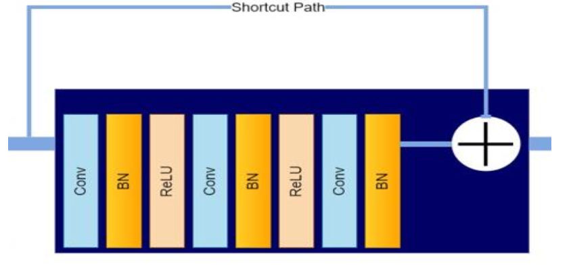
Residual Block

Slide 16
DATASET (Image Super Resolution dataset from Unsplash)
The dataset has been collected from Unsplash.com (https://unsplash.com/data).
It provides the world's largest open library dataset for free.
The Unsplash Dataset is created by 250,000+ contributing photographers and billions of searches across thousands of applications, uses, and contexts.

Slide 17
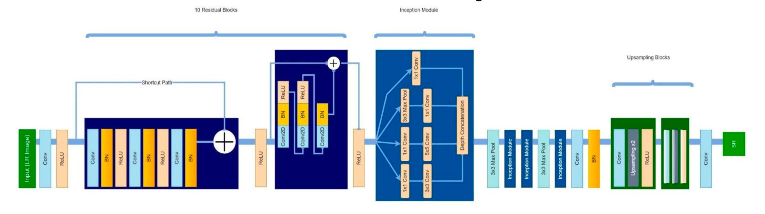
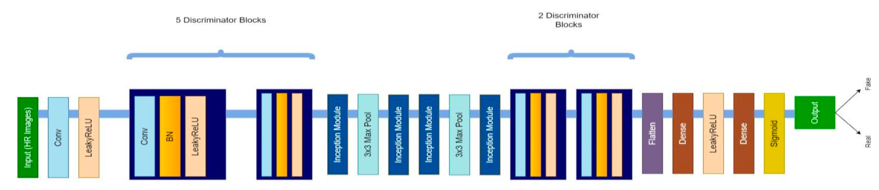
MODEL ARCHITECTURE
Fig. 2. Proposed architecture of Generator network
Fig. 3. Proposed architecture of Discriminator network

Slide 18
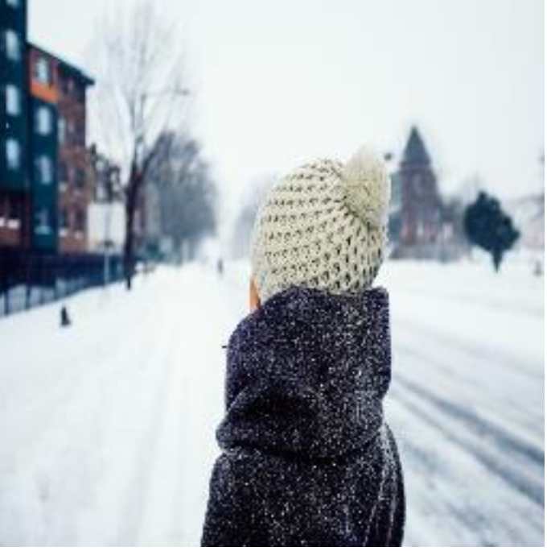
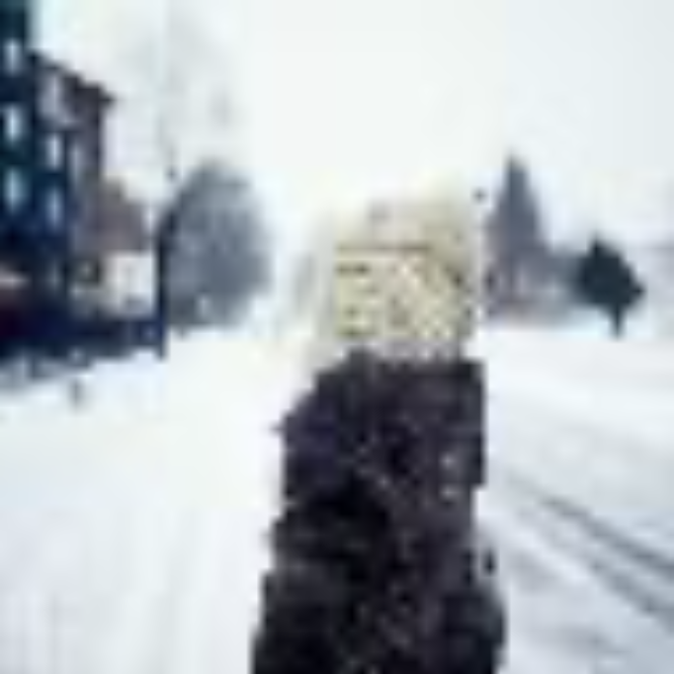
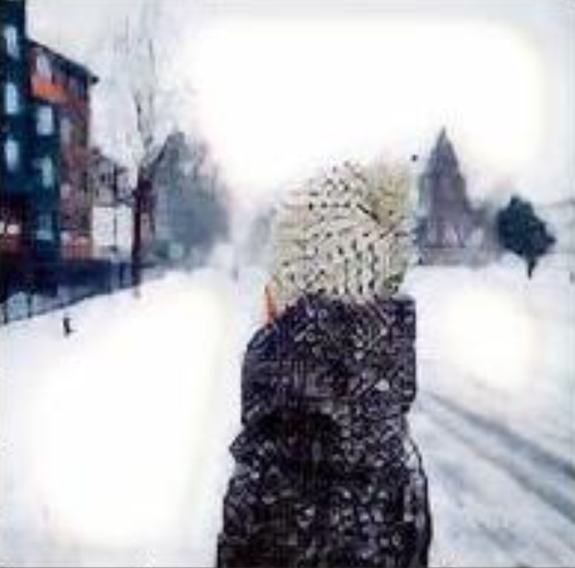
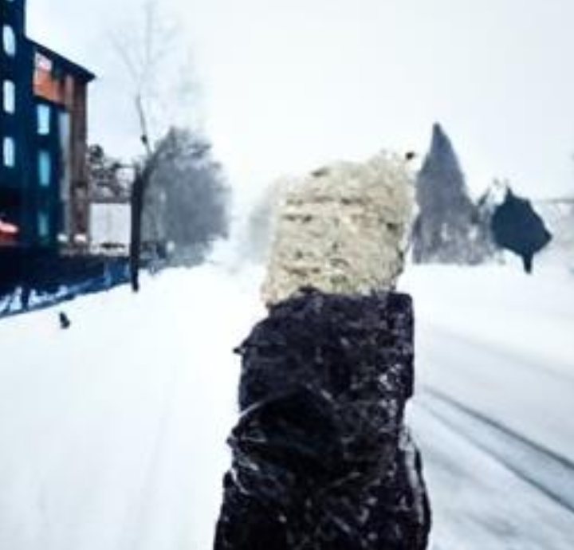
OUTPUT
Fig. 4. Original HR image
Fig. 5. Original LR image
Fig. 6. Image super-resolved by presented model
Fig. 7. Image super-resolved by SRGAN [1]

Slide 19
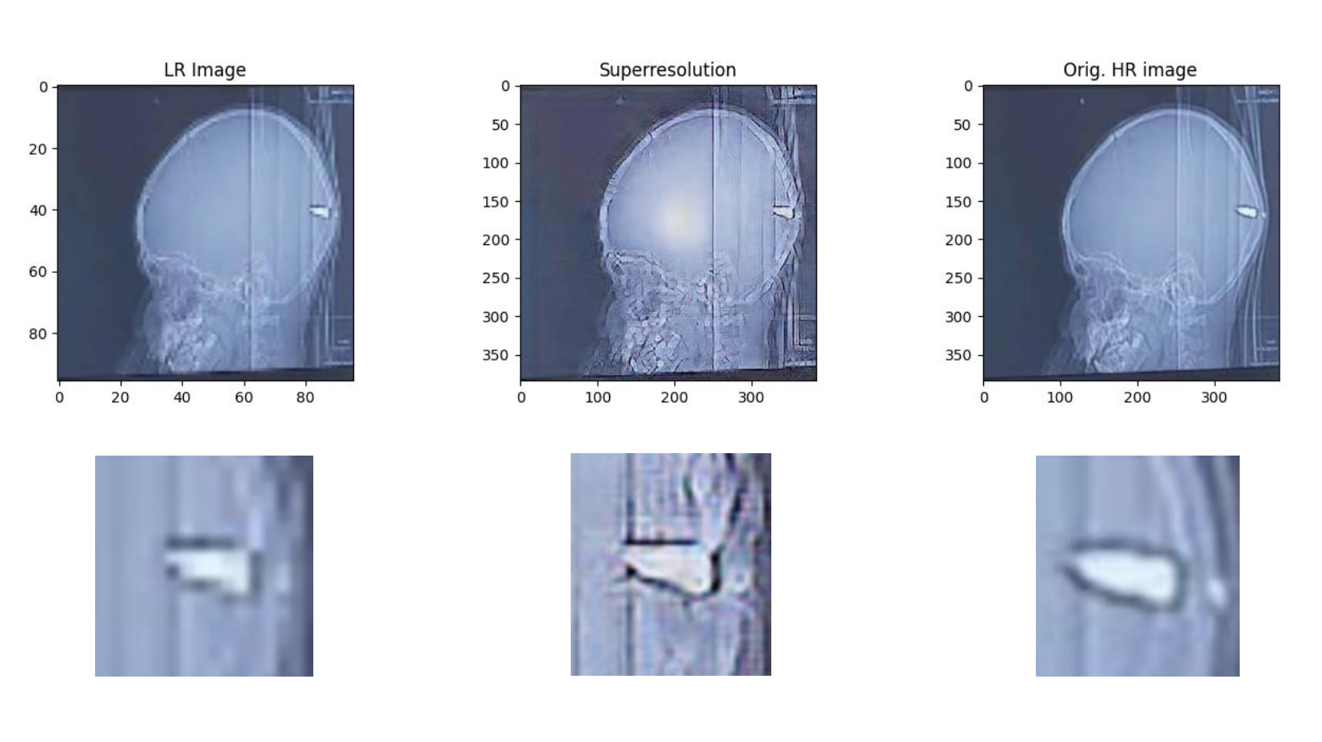
OUTPUT
Fig. 8. Example of SR in medicine

Slide 20
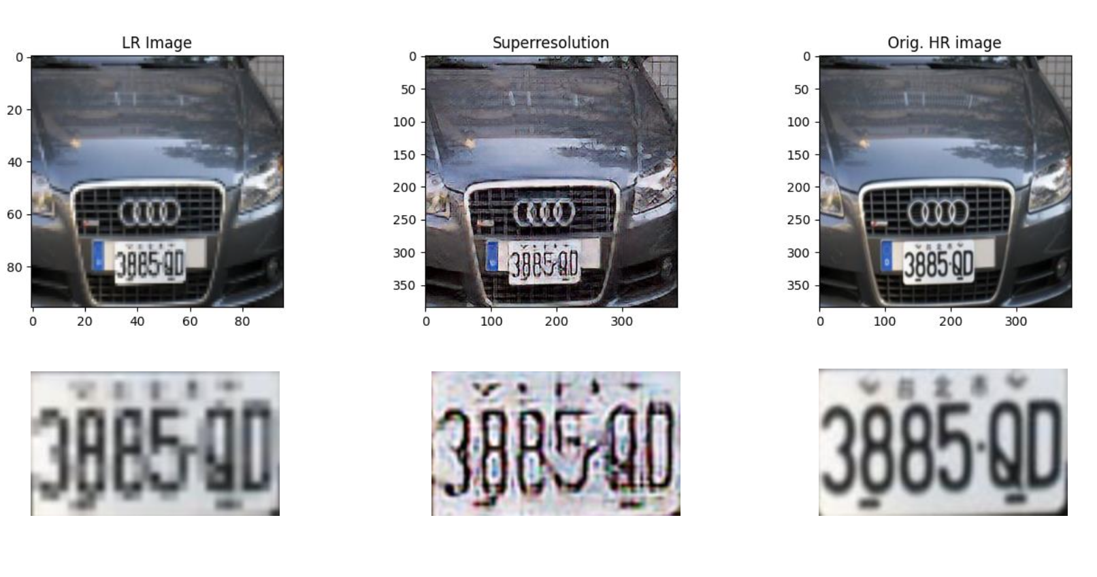
OUTPUT
Fig. 9. Example of SR in surveillance

Slide 21
FUTURE SCOPE
We intend to investigate the network to give better results with higher upscaling factors by increasing the training data and training the model for more epochs to obtain better results.
The network architecture can be further improved by adding more skip connections.
The model can be further deployed by building a proper GUI such as a website so that it can be used more efficiently and easily.
Currently, resizing the image to 96x96 and 384x384 pixels is required for super-resolution. The model needs to be modified so that no specific resizing is required and image of any size can be super-resolved.

Slide 22
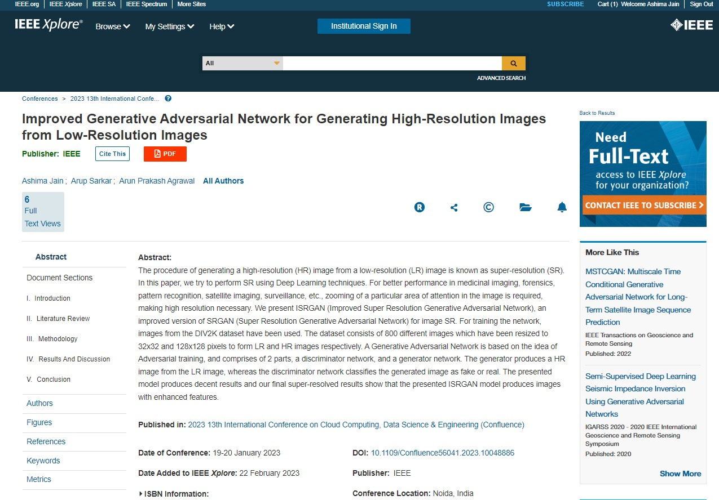
Last Semester Outcome
https://ieeexplore.ieee.org/abstract/document/10048886

Slide 23
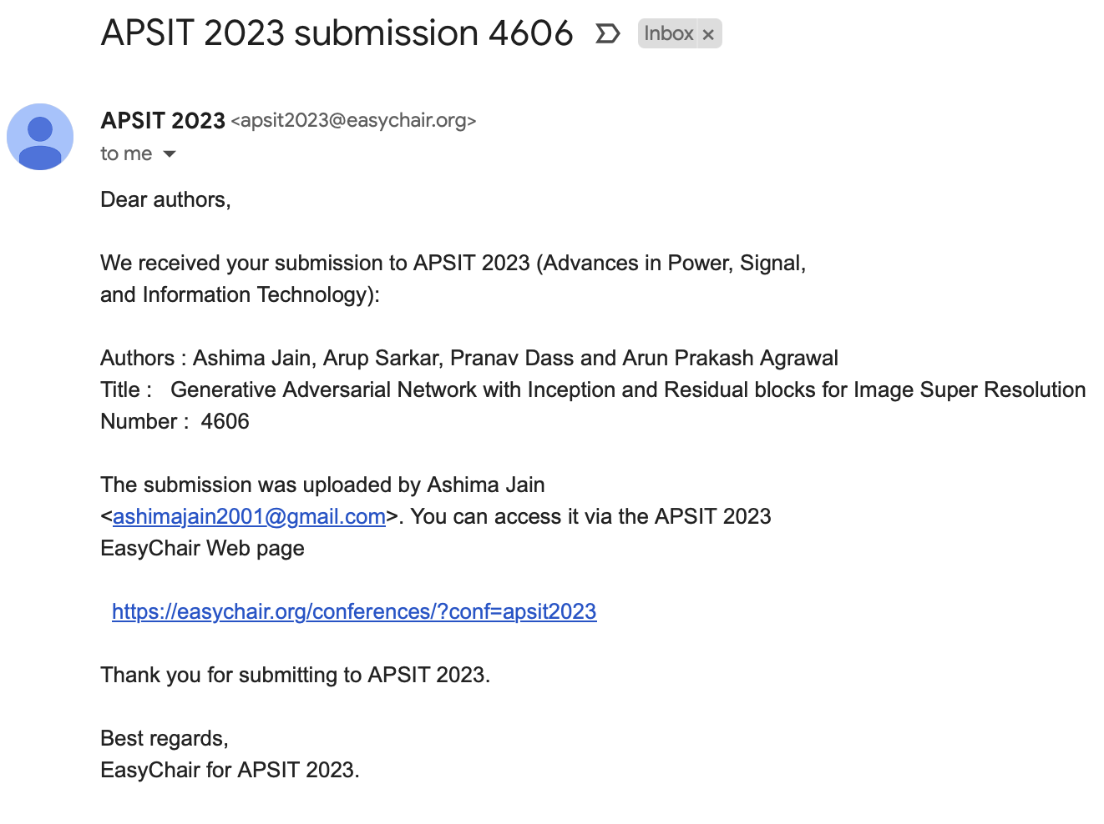
8th Semester Outcome

Slide 24
References
[1] Dong, C., Loy, C. C., He, K., & Tang, X. (2014). Learning a deep convolutional network for image super-resolution. In Computer Vision–ECCV 2014: 13th European Conference, Zurich, Switzerland, September 6-12, 2014, Proceedings, Part IV 13 (pp. 184-199). Springer International Publishing.
[2] Shi, W., Caballero, J., Huszár, F., Totz, J., Aitken, A. P., Bishop, R., ... & Wang, Z. (2016). Real-time single image and video super-resolution using an efficient sub-pixel convolutional neural network. In Proceedings of the IEEE conference on computer vision and pattern recognition (pp. 1874-1883).
[3] Dong, C., Loy, C. C., & Tang, X. (2016). Accelerating the super-resolution convolutional neural network. In Computer Vision–ECCV 2016: 14th European Conference, Amsterdam, The Netherlands, October 11-14, 2016, Proceedings, Part II 14 (pp. 391-407). Springer International Publishing.
[4] Ledig, C., Theis, L., Huszár, F., Caballero, J., Cunningham, A., Acosta, A., ... & Shi, W. (2017). Photo-realistic single image super-resolution using a generative adversarial network. In Proceedings of the IEEE conference on computer vision and pattern recognition (pp. 4681-4690).

Slide 25
[5] N. Ahn, B. Kang, and K.-A. Sohn, “Fast, accurate, and lightweight super-resolution with cascading residual network,” Proceedings of the European conference on computer vision (ECCV), pp. 252–268, 2018.
[6] X. Wang, K. Yu, S. Wu, J. Gu, Y. Liu, C. Dong, Y. Qiao, and C. C. Loy, “Esrgan: Enhanced super-resolution generative adversarial networks,” In Proceedings of the European conference on computer vision (ECCV) workshops, 2018.
[7] Park, S. J., Son, H., Cho, S., Hong, K. S., & Lee, S. (2018). Srfeat: Single image super-resolution with feature discrimination. In Proceedings of the European conference on computer vision (ECCV) (pp. 439-455).
[8] Zhang, W., Liu, Y., Dong, C., & Qiao, Y. (2019). Ranksrgan: Generative adversarial networks with ranker for image super-resolution. In Proceedings of the IEEE/CVF International Conference on Computer Vision (pp. 3096-3105).
[9] Rakotonirina, N. C., & Rasoanaivo, A. (2020, May). ESRGAN+: Further improving enhanced super-resolution generative adversarial network. In ICASSP 2020-2020 IEEE International Conference on Acoustics, Speech and Signal Processing (ICASSP) (pp. 3637-3641). IEEE.

Slide 26
GitHub link
https://github.com/Ashima-Jain2001/GAN-Inception-Residual-SR

